Slide 1


A Relational Model, Workflows, and Parallel Computing to Improve Water Resources Modeling and Management
Adel M. Abdallah PhD Dissertation Proposal Defense
December 3, 2015

Slide 2
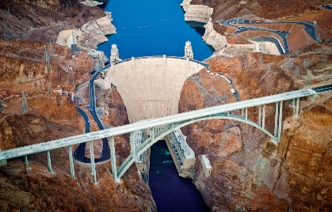
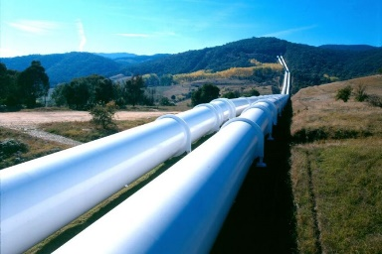

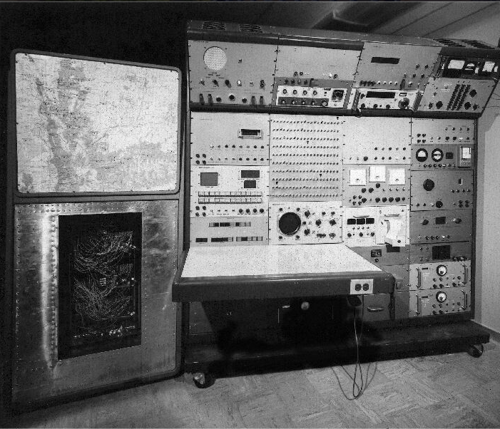
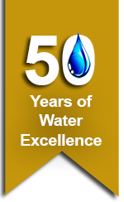
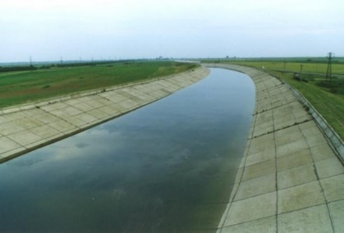
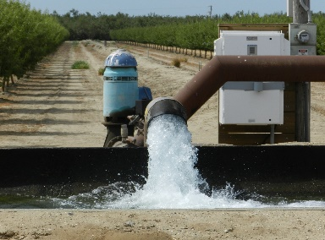
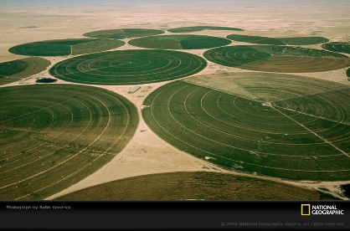
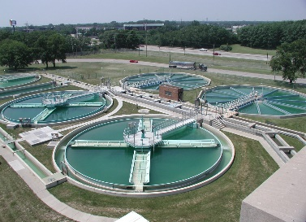
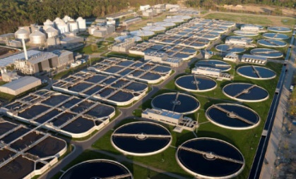
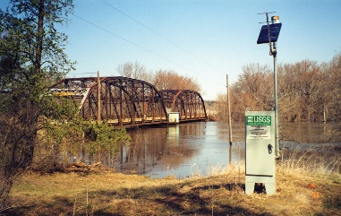
After 50 years of water data collection and modeling, how can we universally organize water management data?
Notes:
2015 marked the 50th anniversary of the Water Lab and also the Water Resources Research Journal
I remember Dr. David Stevens saying once is his statists class that back in those days we used to spend a long time in the field collecting data and little time analyzing the little data we get. But today we spend much less time in the field and much more time in analyzing data.
This is true not only because we have advances sensors and data collection technology…..
Today we have lots of data sources at different locations
Data suppliers use different terminology, different formats, different structures to organize data

Slide 3

Overall Research Motivation
“How can we best structure data and computer models to address scientiﬁc problems through the use of high-performance and data-intensive computing…”

Slide 4
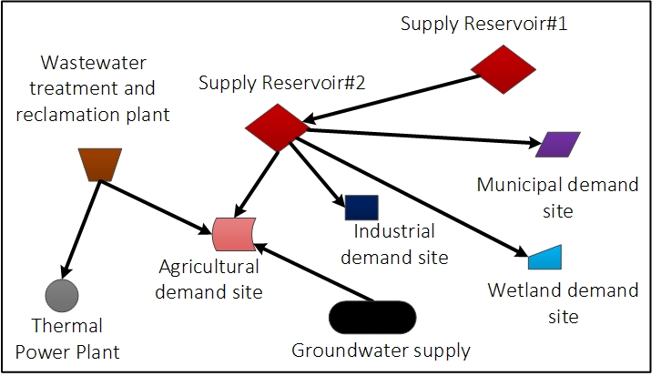
Scope: Systems Modeling
Notes:
I listed listed the most important questions that water resources managers and modelers need WaM-DaM to answer. These questions include:
1) What are the water management instances and attributes in a geographic and domain area of interest?
2) How are these instances physically connected to each other?
3) What are the differences between the input data for two model scenarios?
4) What data is available to run a particular model in a particular place?

Slide 5
Outline
Paper One: A General Relational Model to Organize and Discover Water Management Data to Facilitate Modeling
Paper Two: Workflows Method to Automate Serving Water Management Data to Models
Paper Three: A Method to Identify Targeted and Synergistic Residential Citywide Water and Energy Conservation Strategies Using Parallel Computing
Tentative Plan to Finish
Notes:
For each part, I will talk about the Motivation, Methods and Results and Benefits of the work

Slide 6
Paper One A General Relational Model to Organize and Discover Water Management Data to Facilitate Modeling

Slide 7
Problem and Motivation
Water management data reside at different sources
Heterogeneous semantic and syntactic methods to organize data
We spend considerable time to discover, compare, and interpret data for models
Notes:
Research Questions:
what is the data structure that can integrate disparate and heterogeneous data for systems-water-management to answer important data questions for models across data sources in a consistent and automated fashion?

Slide 8
Paradigm Shift in Water Resources Management Software
Notes:
Researchers and managers want to re-use existing generic user interface and data management systems to work for their models.
Researchers mostly spend their time on developing their algorithms or models. They rarely spend time to develop new database or user interface for their models.
Providing a generic database and user interface can allow users to hook their models to these tools
Mention HydroPlatform as the pioneering software in this regard
Users spend up to 70% of their time in preparing data for their models

Slide 9
Prior Approaches and WaM-DaM Principles
# | Principle | HEC- DSS | ODM | Hydro Platform | SWAT | WEAP | River-Ware | WaM-DaM
1 | Flexible and extensible modular design |  | X | X |  |  |  | X
2 | Networks |  |  | X | X | X | X | X
3 | Scenarios | X |  |  |  | X | X | X
4 | Conditional query | X | X |  |  |  |  | X
5 | Extensible controlled vocabulary |  | X |  |  |  |  | X
6 | Reusable descriptive & explicit metadata |  | X |  |  |  |  | X
7 | Multiple data formats for systems models | X |  | X | X | X | X | X
8 | Open-source environment |  | X | X |  |  |  | X
Notes:
In developing WaM-DaM, we reviewed the 30 existing systems shown in the table on slide 4 to see how the systems organize their data in time, space, and data formats
We found eight common features across these systems
1. Flexible and extensible: allows users to define new user customized objects and then create instances
2. Networks: represents connectivity between water system components
3. Scenarios: supports data changes in networks due to management alternatives
4. Relational and conditional query supports conditional data queries. Conditional queries are important to export pieces of data to others models
5. Dynamic controlled vocabulary: allows users to define vocabulary to control descriptive terms used
6. Descriptive and explicit metadata: uses descriptive and explicit metadata as methods, sources, and units
7. Multiple data types: accommodates multiple data formats like time series, multi-columns, parameters, and functions
8. Open source environment: has the data management system as an open source and non-proprietary, source code and schema are available to the public and uses free software environment.
Its important to note that many of these features may interact and WaM-DaM supports this interaction. For example, Arc Hydro separately supports conditional queries and metadata. But users cannot define metadata and share it in a relational way across different components.
So a generic data management system should support all these features to meet the diverse needs of water management systems.

Slide 10
Methods
What are the required types of water system components and their attributes for a model?
What is the data value(s) of an attribute of a system component?
Where did the data come from for an attribute, who reported them, and using what method?
Notes:
The design was made to efficiently answer these and several other key questions. The design proceeded iteratively as feedback from colleagues and testing through the use cases raised several issues.
WaM-DaM is set of related tables divided into four components: (45 tables)
A core structure shown in light blue allows users to define custom data structures, object types, and properties for a model and it’s components. The user can also create instances and populate the instances with data for specific networks and scenarios.
2) Metadata shown in orange provide information to correctly interpret the attributes, instances, and stored data values.
3) Controlled Vocabulary in purple imposes consistency in the terms used. Users must use terms to describe their data from a pre-defined list of vocabularies if they choose to share or publish their data. The controlled vocabulary table is connected to tables like Object Types, Attributes, and units (connections are not shown for simplicity).
4) Data Values in light red allow users to store data values in the multiple data formats that water resources managers and modes use.
This design has been implemented both as a logical data model (shown in the last slide) and as a physical SQLite database.

Slide 11
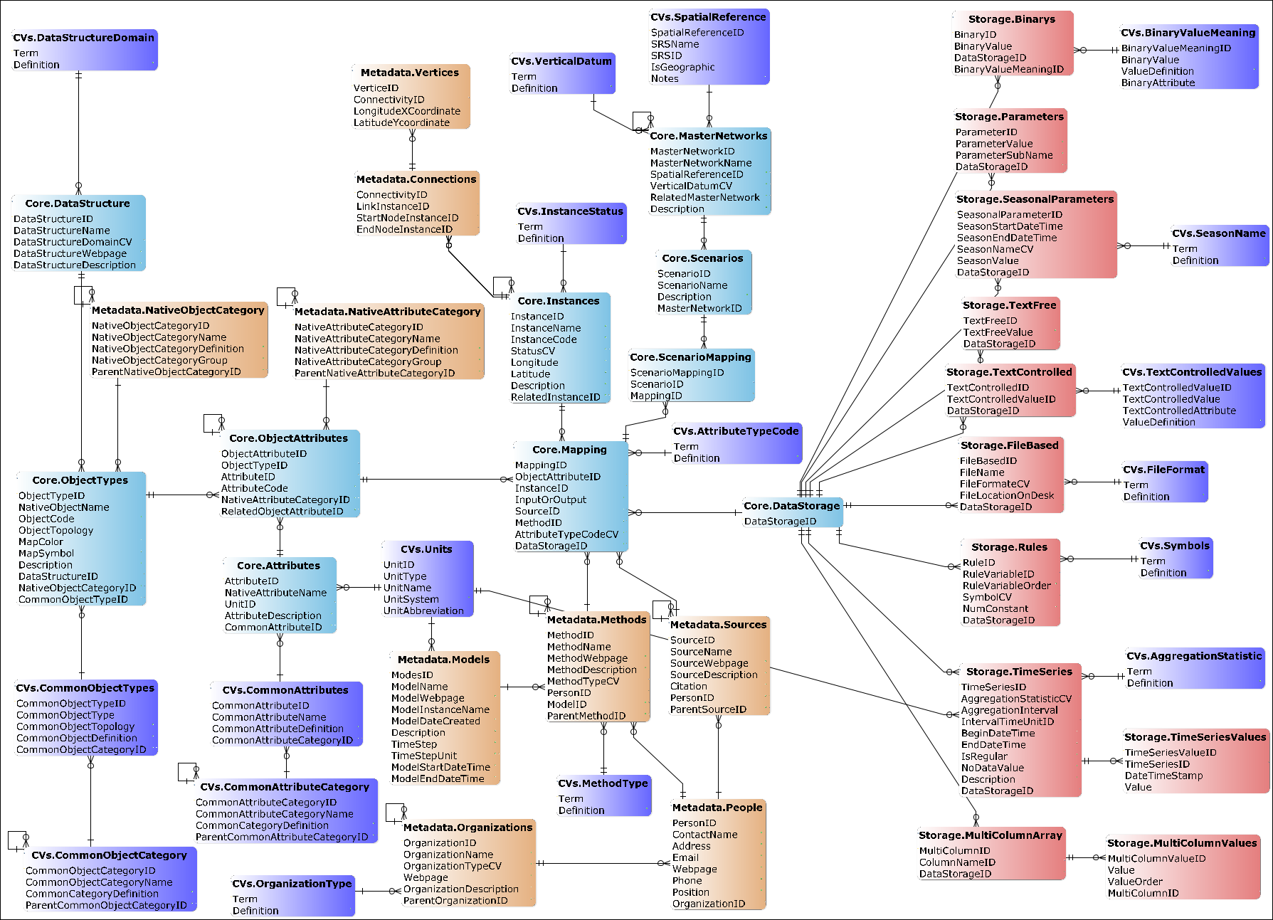
WaM-DaM Logical Data Model
RDBMS
Notes:
I used the relational models because it has standard querying language (SQL) across different commercial RDMS technologies. Thus WaM-DaM is platform independent and not limited to a single database system

Slide 12
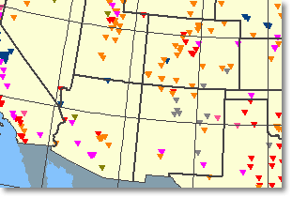
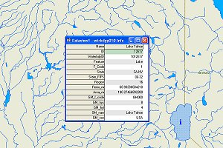
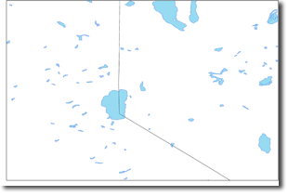

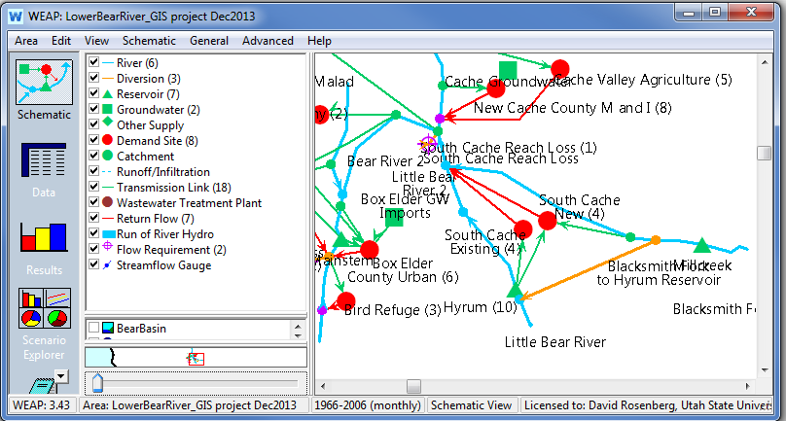



Testing WaM-DaM Design
US Dams dataset
23 attributes
8,121 instances
US Water Bodies and Wetlands Dataset
15 attributes
26,872 instances
Streams Network
22 attributes
76,976 instances
WEAP Model
Lower Bear River, UT
200 attributes
53 instances
Time Series data
120 instances
32 attributes
Notes:
Talk about testing and demonstrating the WaM-DaM design…
These different data sources are heterogeneous (use different semantics and syntax) , reside at different places, and have different formats ( shapefile, WEAP database, txt files)
In the next couple of slides, I’ll show results to important data and modeling questions using WaM-DaM

Slide 13
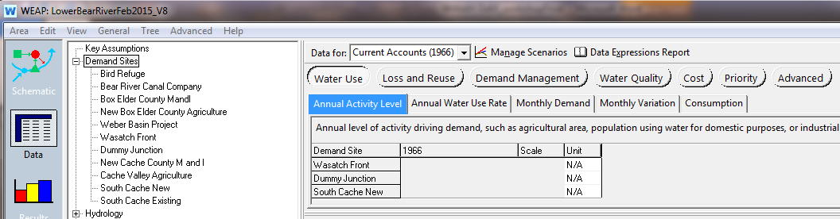
What are the required attributes for the WEAP model?
Object Type | Object Topology | Native Attribute Name
Demand Site | Node | Consumption
Groundwater | Node | Storage Capacity
Reservoir | Node | Capacity
Return Flow | Link | Loss to Groundwater
River | Link | Headflow
Transmission Link | Link | Capital Costs
Notes:
After defining the required data for WEAP in WaM-DaM, now we can query the required data for WEAP in WaM-DaM to nay project, anywhere
Similarly we can do the same and define data requirements for the SWAT model

Slide 14
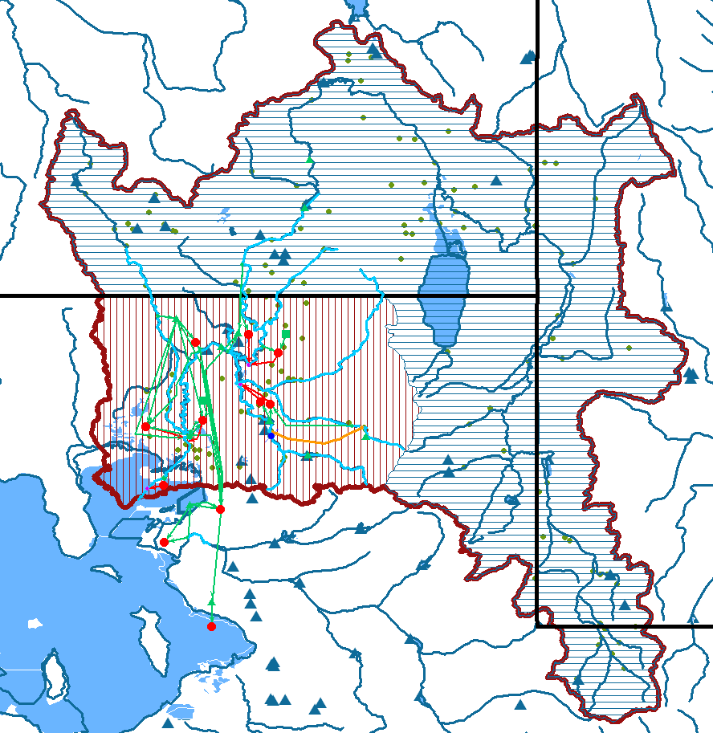
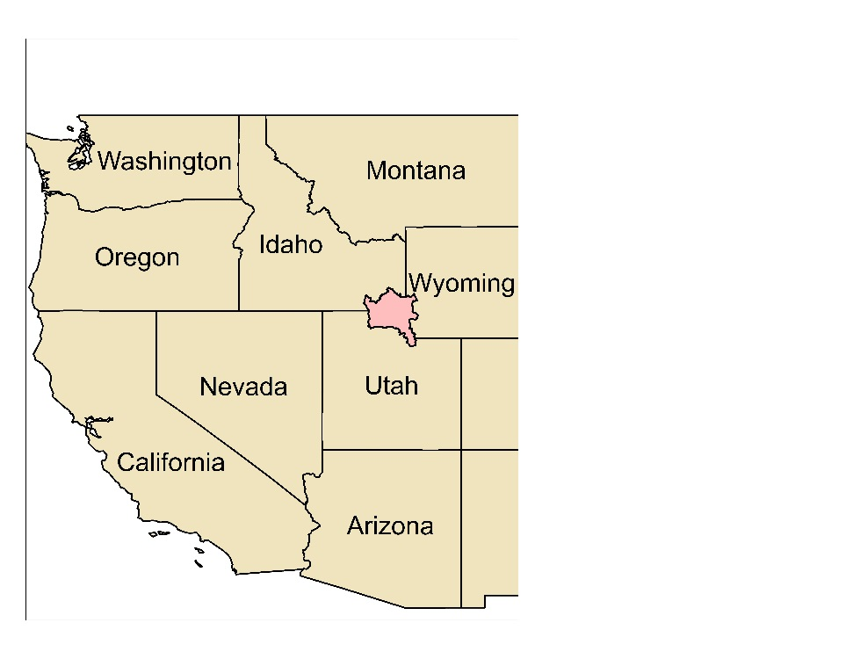
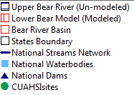
What are the available water system infrastructure components to expand the Lower Bear River Model to the entire Bear River Watershed?
Object Name | # Instances | # Attributes | Source
Gage Station | 44 | 3 | CUAHSI Sites
Reservoir | 11 | 20 | National Dams
Stream | 20 | 3 | National Streams
Notes:
Types in Use Case #1 to search for instances within the boundary of the Upper Bear River. The query result lists 44 Stream Gages, 20 Stream segments, 11 reservoirs, and seven water bodies that are available in WaM-DaM for the upper Bear River Basin boundary that matches the WEAP required Object Types
We can use the model to search for data anywhere.
Mention that in a workshop in Tuscaloosa Alabama, I showed the available instances for a WEAP model in that Region

Slide 15
What is the "surface area" of an object type "Reservoir" within a boundary of lat. and long.?
Instance Name | Source Name | Common Object Name | Native Object Name | Common Attribute Name | Native Attribute Name | Unit Name | Parameter Value
Hyrum Reservoir | Water Bodies Dataset | Reservoir | Water Body | surface area | Area_mi | square mile | 0.705559 ~452 acre
Hyrum (10) | WEAP/ Lower Bear River Network | Reservoir | Reservoir | surface area | Area | Acre | 480
HYRUM | Dams Dataset | Reservoir | Dam | surface area | SURF_AREA | Acre | 480
Notes:
Another important question is What is the "surface area" of an object type "Reservoir" within a boundary of lat. and long. ?
The table shows the results of the query. There are three instances of Hyrum Reservoir that come from three difference data sources. The use of common vocabulary and registering native vocabulary against them allows us to search different terms like surface area by using the common name.
The user can identify discrepancies among the data sources and incorporate them in their model uncertainty

Slide 16
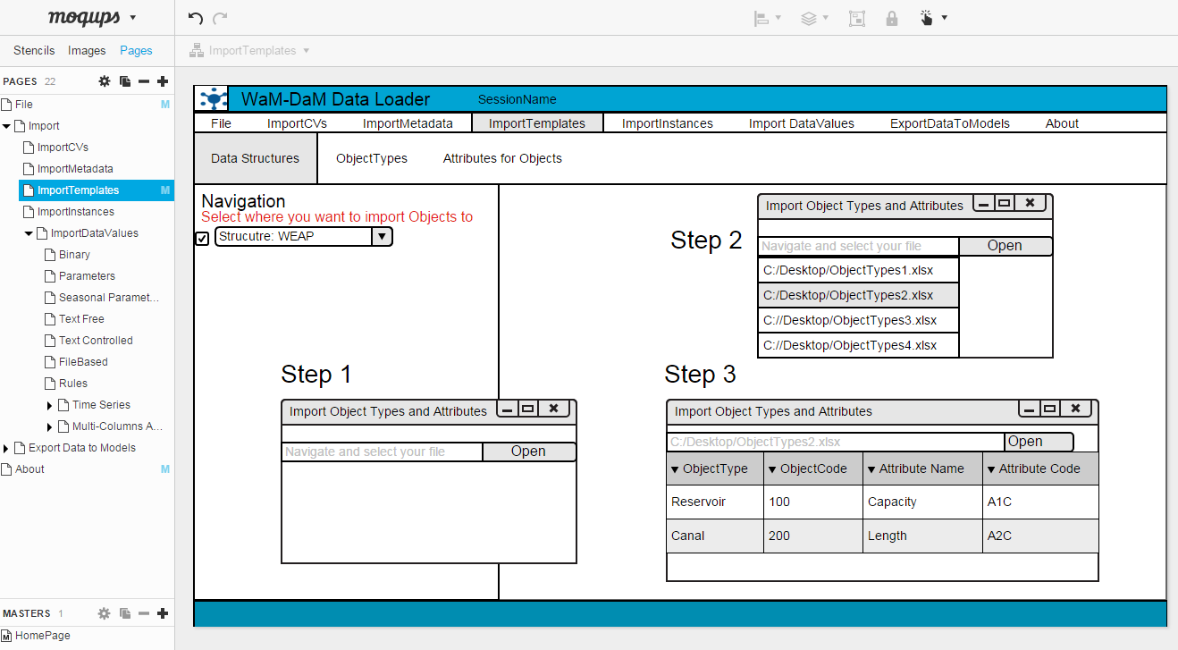

Next: Design WaM-DaM Data Loader
Notes:
Of course users want a friendly way with graphically user interface to import their data. Here I designed a mock up for the data loader. I will use Visual Studio and its Python tool extension to build the GUI to run as an executable on a windows machine. The GUI will connect to a local or remote SQLite WaM-DaM database

Slide 17
Contributions #1
A persistent information model that overcomes semantic and syntactic heterogeneities of water management data
Supports eight design principles altogether to answer key data questions for modeling
A consistent method to discover water management data for models

Slide 18
Paper Two Workflows Method to Automate Serving Water Management Data to Models

Slide 19
Problem and Motivation
We spend a considerable time to populate models with data
We need reproducible methods to populate models with data
Document input data with metadata to promote modeling transparency
Notes:
Research Questions:
what are the systematic steps to query, transform, and export management data in a reproducible and automated fashion that improve the manual existing and time-consuming steps to answer different water management questions?

Slide 20
Method: workflows to automate serving data to WEAP And SWAT Models
Existing practices
Proposed Method
Automate:
Identification
Extraction
Transformations
Output
Notes:
Compare results of different methods
Re-use the workflows in other study areas
Back up model input data with metadata for transparency
The workflow steps are:
convert the semantics of the extracted data into the required semantics at the destination (name of object and attribute),
convert the unit,
restructure the rows and columns of data,
order of data values (water year or calendar year for time series data),
reformat date and time, and vi) aggregate or disaggregate data values as required (i.e., convert from daily to monthly or vice versa).

Slide 21
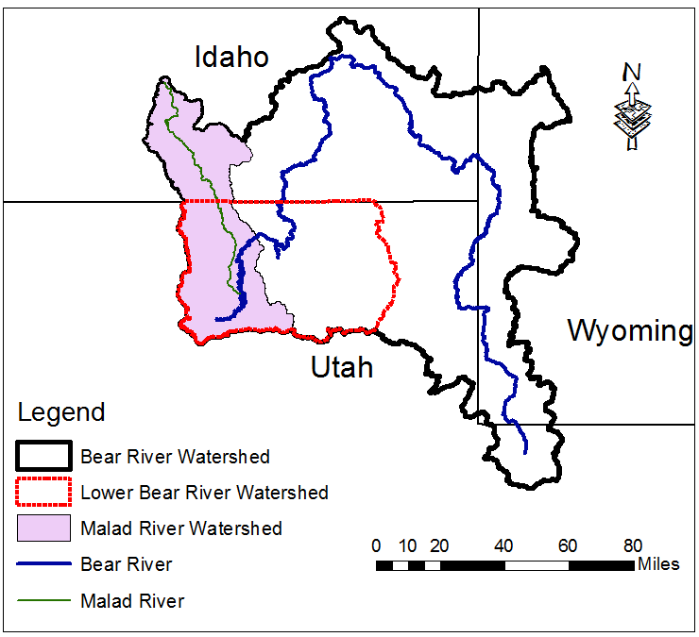
Methods…cont.
Share the same data across models in WaM-DaM
Develop workflows to serve data to SWAT and WEAP models
Verify workflows for existing models and then use them to expand the models to the entire watershed
Notes:
Compare results of different methods
Re-use the workflows in other study areas
Back model input data with metadata for transparency
The workflow steps are:
convert the semantics of the extracted data into the required semantics at the destination (name of object and attribute),
convert the unit,
restructure the rows and columns of data,
order of data values (water year or calendar year for time series data),
reformat date and time, and vi) aggregate or disaggregate data values as required (i.e., convert from daily to monthly or vice versa).
I expect to take six months to complete this paper

Slide 22
Contributions #2
Use WaM-DaM as a common-access-data-storage for models
Develop reproducible workflows to automate serving water management models with data
Use the same data to answer different water management questions
Notes:
how to allocate water supplies to meet urban and agriculture demands?
what is the effect of agriculture practices on surface water quality?

Slide 23
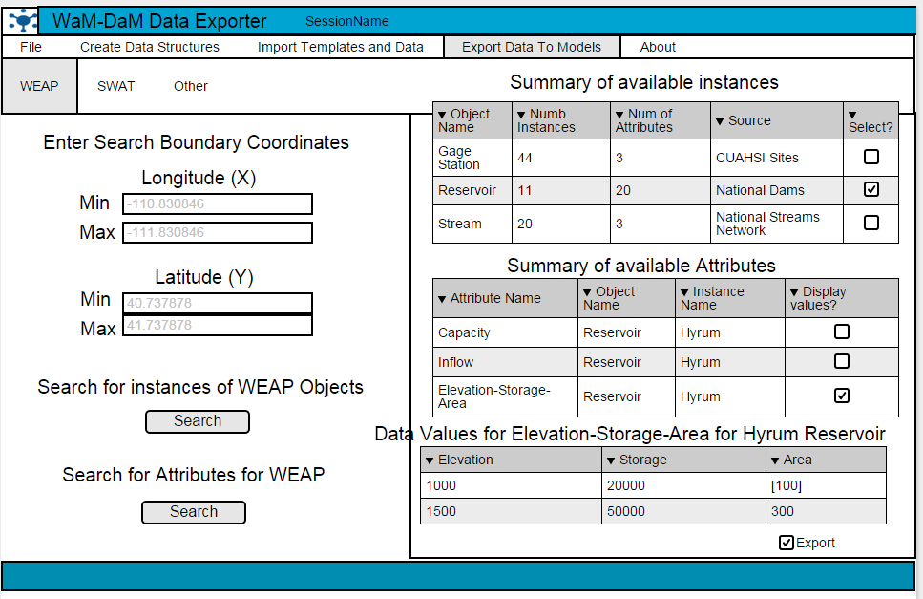
Next: Design WaM-DaM Data Exporter

Slide 24
Paper Three A Method to Identify Targeted and Synergistic Residential Citywide Water and Energy Conservation Strategies Using Parallel Computing

Slide 25
Problem and Motivation
Cities need to exploit water and energy nexus to conserve both resources to meet conservation goals
How to design targeted conservation strategies
Solving complex optimization models is time intensive using traditional computation methods
Notes:
A recent performance audit by the Utah Legislature underscored the importance of indoor and outdoor water conservation and policy choices to meet the State’s water conservation goal.
The audit also underscored the importance of reducing the per capital water consumption beyond the States goal to avoid the development of future expensive infrastructure projects.
Utah will need to spend $33 billion over the next several decades to repair existing water systems and add additional supply.
On the energy conservation side, Salt Lake City set a goal to reduce energy consumption by 70% by 2050
Nationally energy utilities spent 45 billion dollors on conservation between 1989 and 2010
Can both water and energy utilities collaborate to conserve both resources at the same time?

Slide 26
Methods: Optimization Model
Decision variables
A mix of water and energy conservation actions (binary) to implement in 40,000 houses in Salt Lake City. Each house could implement up to 25 actions at a time
Objective function
Minimize citywide implementation cost of conservation actions
Subject to:
Meet city variable water reduction targets (0-50% with 1% increments)
Meet city variable energy reduction target (0-50% with 1% increments)
Satisfy lower and upper bounds on city conservation actions
Satisfy upper bounds of payback period for actions (i.e., 5 years)

Slide 27
Identify the Effect of Decision Variables and Scenarios on Execution Time
Notes:
First, explain the size of the problem (scenarios and decision variables)
Which one has more effect on execution time, the number of decision variables or the number of scenarios? the answer allows us to exploit the factor that has the least effect to the max potential. Then find away to exploit the second factor more wisely (e.g., use larger steps between its values) or avoid too low or two high values that are not realistic

Slide 28
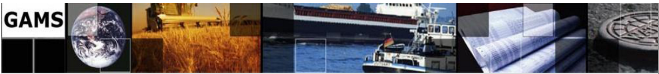
Parallel Commuting Methods
1. Solve the optimization problem in parallel
2. Solve independent optimization models in parallel
Notes:
Preliminary results show that the first option doesn’t decrease the execution time due to expensive communications between the Master and Worker to report optimal solutions
Preliminary results of the second option showed a cut in half of the execution time for two processors but this time doesn’t decrease anymore after increasing the cores beyond two processors. It turns out that setting up the independent scenarios in GAMS runs in sequence. Setting up each model takes about the time to solve the model

Slide 29
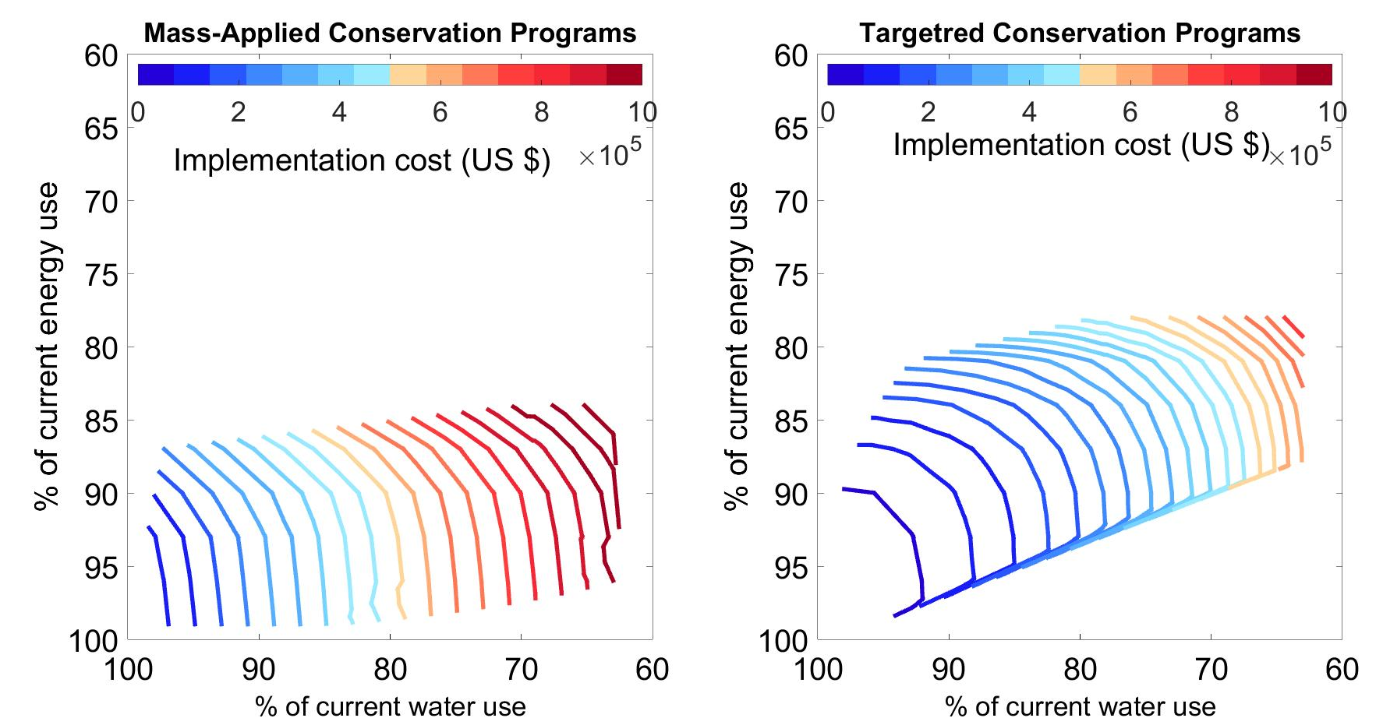
Results: Parallel computing allows us to explore more potential solutions
Notes:
Targeted and collaborative conservation is cheaper and faster to meet targets
It cost $180,000 to implement 1,500 actions to reduce water and energy uses by 15%
It cost $650,000 to implement 3,500 actions to reduce water and energy uses by 15%

Slide 30
Next Steps
Incorporate outdoor water use component and consider mutual inclusive and exclusive actions
Identify the elasticity of decision variables and scenarios on execution time
Use WaM-DaM to organize the model’s input and output data

Slide 31
Contributions #3
A novel optimization method to identify synergistic, targeted, and cost-effective water and energy conservation strategies
Identify the economic benefits of targeted vs mass-applied conservation approaches
Identify the elasticity of the important factors in model execution time using parallel computing

Slide 32
Tentative Plan to Finish
Today
 |  | 2012 | 2013 |  |  | 2014 |  |  | 2015 |  |  | 2016
# | Milestone | Fall | Spring | Summer | Fall | Spring | Summer | Fall | Spring | Summer | Fall | Spring | Summer | Fall
1 | Finish coursework and review literature
2 | Design WaM-DaM and test it through use cases
 | Write and defend proposal
 | Design WaM-DaM Data Loader
 | Finalize and submit the WaM-DaM paper
4 | Develop workflows to transfer data to models
 | Design workflow GUI
 | Write and submit the Workflows paper
3 | Develop WaterEnergy model and execute in Parallel
 | Finalize model and report results
 | Write and submit the Water and Energy Model paper
5 | Finalized Dissertation Chapters
 | Defend dissertation and graduate
Design WaM-DaM Data Loader
Develop workflows and design their GUI
Finalize Water-Energy model and use parallel computing to identify tradeoffs

Slide 33
Conclusions
Proposed three novel methods to improve water resources modeling and management
WaM-DaM: persistent data model to organize and discover water management data
Workflows to automate serving water management data to models
A method to identify water and energy conservation strategies using parallel computing
Plan to complete proposed work by Fall 2016.

Slide 34

Acknowledgements
Committee members: David Rosenberg, David Tarboton, Jeff Horsburgh, Steve Burian, and Sarah Null
Pabitra Dash
Steve Knox: University of Manchester
Josue Medellin-Azuara and Quinn Hart: University of California, Davis
Stephanie Duer Water Conservation Manager, Salt Lake City, Department of Public Utilities
Kelly Kopp: WaterChecks Program
Steve Burian and Urban Water Research Group

Slide 35
Thank you for your attention!
Questions?

Slide 36
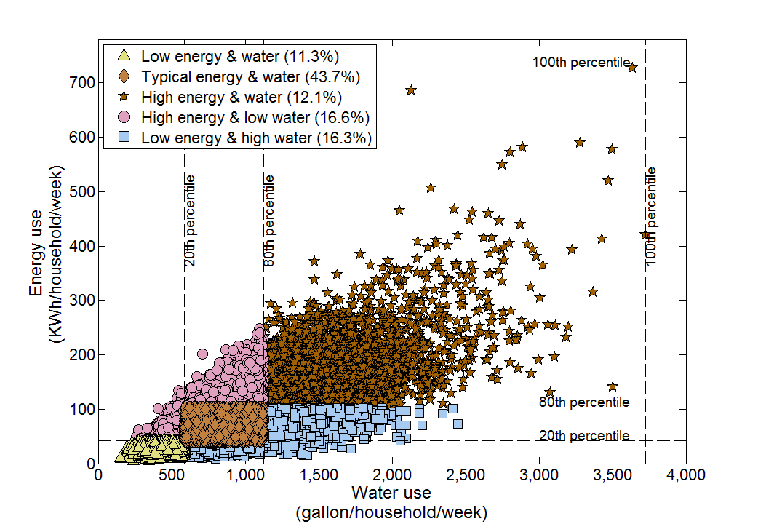
Heterogeneous water and energy and uses (largest 12% of users use 21% and 24% of water and energy)
Notes:
The green circle in the middle represents the average value which is widely used to model water and energy linkages. But in our study we want to exploit this heterogeneity by targeting the high users first

